Slide 1
Nuclear Weapons, military & climate overheating
Dr Philip Webber, Chair
http://www.sgr.org.uk/
Notes:
Presentation to Nuclear weapons & climate change 9 September 2021 Westminster Hall
I use the term climate ‘overheating’ because the IPCC are now clear that we are in an emergency situation. We are well beyond climate ‘change’.

Slide 2
Military spending hits record levels, while climate finance falls short
The Intergovernmental Panel on Climate Change (IPCC) warns that climate heating can destabilise societies, increasing the risk of violent conflict
Many examples: eg Syria, Afghanistan
Notes:
https://www.sgr.org.uk/resources/military-spending-hits-record-levels-while-climate-finance-falls-short
Other examples include Sub-Saharan Africa and rise of rebel groups.

Slide 3
Global military spending 2020
Just under $2trillion – ($2000 billion) (SIPRI)
Climate investment required: $1000 billion
Actual climate spending $400 bn
Shortfall = 1/3 of military spending
Notes:
Sources: SIPRI 2021 https://www.sipri.org/media/press-release/2021/world-military-spending-rises-almost-2-trillion-2020 and SGR data & analysis at
https://www.sgr.org.uk/resources/military-spending-hits-record-levels-while-climate-finance-falls-short

Slide 4
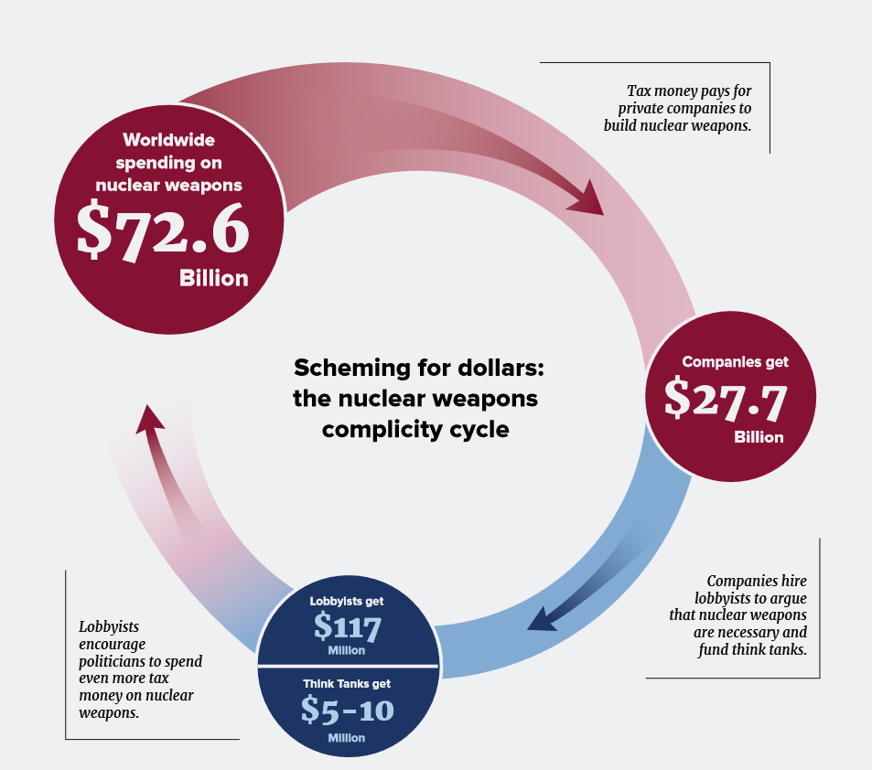
Notes:
ICAN ‘Complicit’ report https://www.icanw.org/2020_global_nuclear_weapons_spending_complicit
Same process applies for conventional weapons programmes. First identified by US President Rooseveldt in 1961. The pervasive influence of the Military industrial Complex.
The ICAN report identifies specific sums used by big arms companies to create the weapons lobby and to create a false narrative re nuclear weapons & ‘deterrence’.
This process leads us to a situation where the population at large are led to believe in the myth of nuclear deterrence promoted by the vested interest of the 9 nuclear-armed nations who largely control the media narrative. In reality, at least 135 nations reject this through the TPNW.

Slide 5
UK Military/ climate –spending
November 2020, UK PM Boris Johnson announces extra spending for military & climate – quotes two prominent numbers…
Extra £16.5bn for Ministry of Defence
£12bn for ‘10 point plan for a Green Industrial Revolution’
Sound similar - but numbers misleading…
Notes:
Sources: Prime Minister’s Office (2020); BEIS (2020).

Slide 6
UK: The reality…
Ministry of Defence
Total extra spending over 4y: £24bn (£6bn/y)
10 point plan for ‘Green Industrial Revolution’
Total spending over 4y: max. £11bn (£2.8bn/y)
Notes:
Sources: Prime Minister’s Office (2020); BEIS (2020).

Slide 7
What climate spending do we need?
Transition to net zero UK carbon emissions requires investment of …
 | Current annual spending | Total necessary annual spending | Target date for zero emissions | Source
Whole economy (govt, business, individuals) | £10bn | £50bn | 2050 | Committee on Climate Change
Govt spending | £5bn | £10bn | 2050 | Committee on Climate Change
Govt spending | £3.1bn | £15bn+ | 2030 | This presentation
Notes:
Figures in 1st two rows from: CCC (2020), table 6.1, p310; ‘necessary’ govt spending is rounded (actual range is £9-12bn)
‘This presentation’ see: https://www.sgr.org.uk/resources/military-spending-hits-record-levels-while-climate-finance-falls-short
Current govt spending has been reduced by £1.9bn as Green Home Grants programme will only spend 5% of its budget this year due to mismanagement (Guardian, 2021)
Figures for meeting 2030 net zero emissions target are hard to find – £15bn is rough minimum estimate

Slide 8
Military v climate: total govt spend
Main sources: HM Treasury (2020); CCC (2020); Guardian (2021)
Military total does not include Trident contingency fund, military pensions etc
No official govt figures for annual climate spending
Notes:
Calculations based on: HM Treasury (2020); CCC (2020); Guardian (2021)

Slide 9
Military v climate: UK govt spend
Main sources: HM Treasury (2020); CCC (2020); Prime Minister’s Office (2020); BEIS (2020); Guardian (2021)
Military total does not include Trident contingency fund, military pensions etc
Extra needed for Net Zero 2030 is minimum value
Notes:
Calculations based on: HM Treasury (2020); CCC (2020); Prime Minister’s Office (2020); BEIS (2020); Guardian (2021)
And we need to speak plainly here. The ‘military’ are equipped with weapons that are specifically designed to kill. New weapons are tested in ongoing war zones. In the case of nuclear weapons, their targeting and fusing in an air burst maximises the ability to obliterate the largest areas through blast and fire and to kill and maim the largest number of people. This used to be referred to as the ‘Moscow criterion’ for UK nuclear weapons by military and political planners. The ability to destroy at least 60% of the infrastructure of a large capital city with multiple targeted warheads. Trident missiles also possess the accuracy to target ‘hardened’ military targets as part of a ‘decapitating’ first strike. Now hopefully abandoned as a concept but once part of USA SIOP (Strategic Integrated Operational Plan).

Slide 10
Global nuclear weapon spending 2020
In 2020 the nine nuclear-armed countries spent $72.6 billion on 13,000+ nuclear weapons,
$137,666 every minute
$1.4 billion increase over 2019
Source: ICAN report ‘Complicit’ (June 2021):

Slide 11
UK nuclear weapons 2020
$ 6,200 million / year
225 warheads
Submarines, warheads, US missile leasing, reactor programme
Plan to increase warheads to 260 !
New subs etc – $42,000m – construction
$270,000m – lifecycle cost
Sources: 2018 National Audit Office, CND, ‘Complicit’

Slide 12
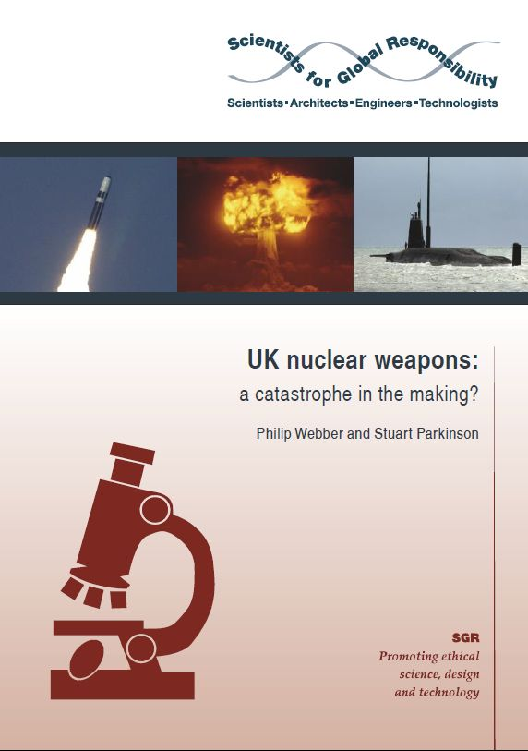
UK military contribution to climate crisis
UK military carbon footprint
At least 11 million tonnes CO2 equivalent
Comparable with annual use of 6 million cars
UK deployment of nuclear weapons
warheads carried by one Trident submarine could cause catastrophic climate cooling due to smoke from explosions/fires blocking Sun’s warmth (‘nuclear winter’).
Similar to ‘regional’ scenarios.
10m blast, radiation, burns casualties…
Notes:
Sources: SGR (2020); SGR (2015)

Slide 13
Job creation: govt projections
Extra £24bn of military tech spending
40,000 jobs in 4y
Extra £11bn spending for 10 point climate plan
90,000 jobs in 4y
So climate spending will create about 5x as many jobs per £bn of govt investment
A similar ratio applies to funding social care
Notes:
Calculations based on sources: BEIS (2020); Prime Minister’s Office (2020).
Womens Budget Group (2021) A care led recovery from corona virus 2021 https://wbg.org.uk/wp-content/uploads/2020/06/Care-led-recovery-final.pdf

Slide 14
UK govt has chosen…
Extra £6bn per year on…
Deploying aircraft carrier group to South China Sea
Playing leading role in robot arms race
Exporting weapons to fossil fuel dictatorships
Deploying nuclear weapons, creating risk of accidental catastrophic nuclear war & nuclear winter
Failing to tackle climate emergency, fuelling rise in instability and war
…rather than extra £7bn per year/ £12bn+ per year on hitting 2050/ 2030 net zero climate target

Slide 15
References
BEIS (2020). The ten point plan for a green industrial revolution. Dept for Business, Energy, and Industrial Strategy. https://www.gov.uk/government/publications/the-ten-point-plan-for-a-green-industrial-revolution
CCC (2020). The sixth carbon budget: the UK's path to net zero. Committee on Climate Change. https://www.theccc.org.uk/publication/sixth-carbon-budget/
ICAN (2021). Complicit: 2020 Global Nuclear Weapon Spending. https://www.icanw.org/2020_global_nuclear_weapons_spending_complicit
The Guardian (2021). Hundreds of millions in green grants for English homes pulled despite delays. 10 February. https://www.theguardian.com/environment/2021/feb/10/hundreds-of-millions-in-green-grants-for-english-homes-pulled-despite-delays
HM Treasury (2020). Spending Review 2020. https://www.gov.uk/government/publications/spending-review-2020-documents
International Energy Agency (2020). Energy Technology RD&D Statistics: online database. http://wds.iea.org/WDS/Common/Login/login.aspx
Office of National Statistics (2020). Research and development expenditure by the UK government: 2018. https://www.ons.gov.uk/economy/governmentpublicsectorandtaxes/researchanddevelopmentexpenditure/bulletins/ukgovernmentexpenditureonscienceengineeringandtechnology/2018
Prime Minister’s Office (2020). PM statement to the House on the Integrated Review. November. https://www.gov.uk/government/speeches/pm-statement-to-the-house-on-the-integrated-review-19-november-2020
SGR (2015). UK nuclear weapons: a catastrophe in the making? (Authors: Philip Webber; Stuart Parkinson) https://www.sgr.org.uk/publications/uk-nuclear-weapons-catastrophe-making
SGR (2020). The environmental impacts of the UK military sector. (Author: Stuart Parkinson) https://www.sgr.org.uk/publications/environmental-impacts-uk-military-sector
SGR (2018) https://www.sgr.org.uk/resources/military-spending-hits-record-levels-while-climate-finance-falls-short
SIPRI (2021). https://www.sipri.org/media/press-release/2021/world-military-spending-rises-almost-2-trillion-2020
Wpg: Women’s Budget Group 2021. A care led recovery from corona virus https://wbg.org.uk/wp-content/uploads/2020/06/Care-led-recovery-final.pdf

